Slide 1

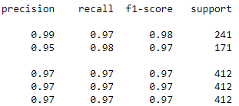

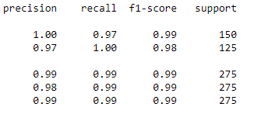

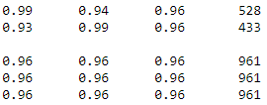

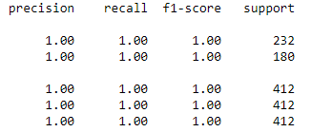

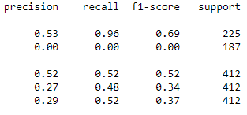

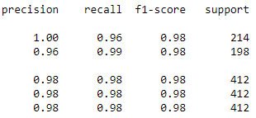

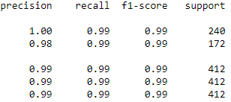

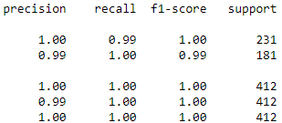

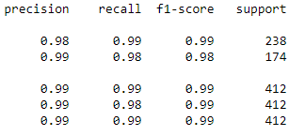

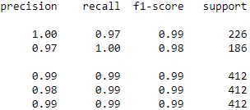

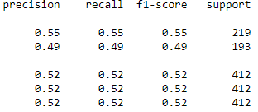
Parameter | 1. Current | 2. Increase | 3. Decrease
a. Train test split | 0.7, 0.3 | (Top 4) 0.8, 0.2 | (Top 3) 0.3, 0.7
b. Classifier: Hidden_layer | 10,20,10 | (Top 1) 20,20,10/10,30,10 | (Top 1) 5,20,10 /10,10,10
c. Classifier: Batch_size | 20 | (Top 2) 40 | 10
d. Classifier: Train Steps | 500 | (Top 3) 800 | (Top 2) 100

